Slide 1
Discovering Requirements
Sara Muneeb
sara.muneeb@cuilahore.edu.pk
Computer Science Department

Slide 2
Introduction
Discovering requirements focuses on exploring the problem space and defining what will be developed
In the case of interaction design, this includes:
understanding the target users
their capabilities
how a new product might support users in their daily lives
users’ current tasks, goals, and contexts
constraints on the product’s performance; and so on.
It may seem artificial to distinguish between requirements, design, and evaluation activities because they are so closely related.

Slide 3
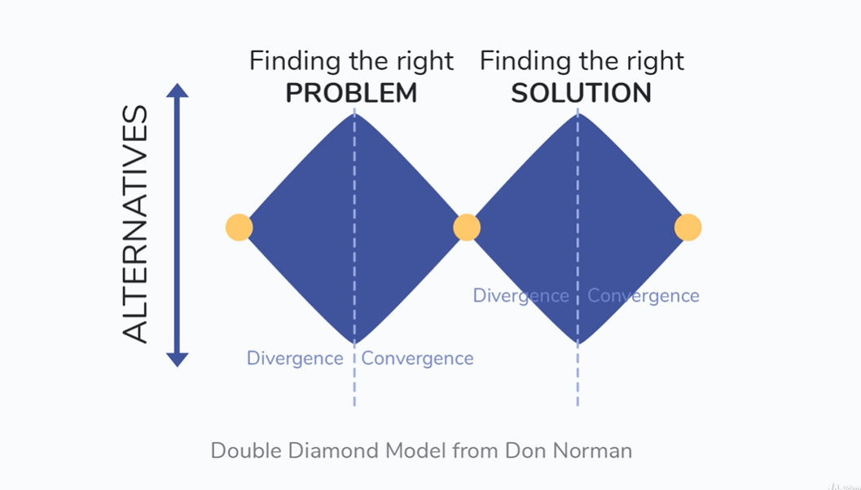
What, Why and How?
What is the purpose of the requirement activity?

Slide 4
What, Why and How?
Requirements may be discovered through targeted activities, or tangentially during product evaluation, prototyping, design, and construction.
Requirements discovery is iterative
The iterative cycles ensure that the lessons learned from any of these activities feed into each other.
In practice, requirements evolve and develop as the stakeholders interact with designs and learn what is possible and how features can be used

Slide 5
What, Why and How?
How to capture requirements once they are discovered?
Requirements may be captured in several different forms.
Interactive products span a wide range of domains with differing constraints and user expectations.
There are different kinds of requirements, and each can be emphasized or de-emphasized by different notations.
prototypes, stories, diagrams, and photographs

Slide 6
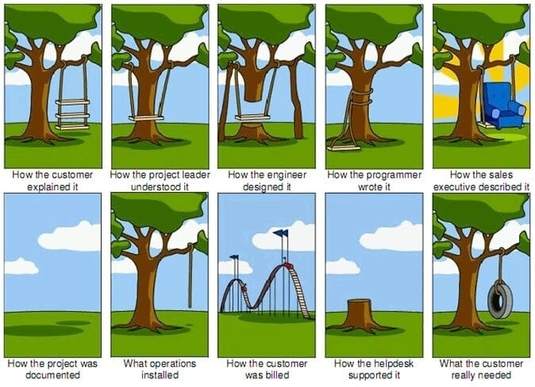
Avoiding Miscomunication
User-centered design with repeated iteration and evaluation along with user involvement mitigates unusable and inappropriate product.

Slide 7
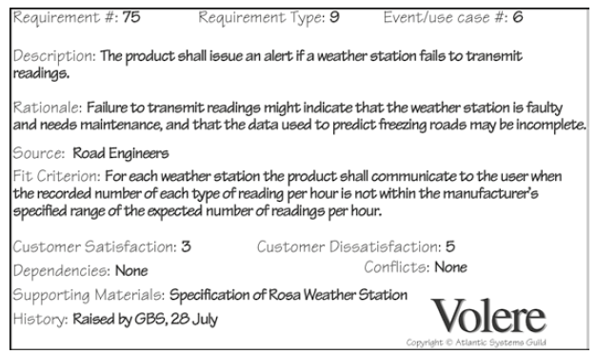
What are requirements?
A requirement is a statement about an intended product that specifies what it is expected to do or how it will perform.
One of the goals of the requirements activity is to identify, clarify, and capture the requirements.

Slide 8
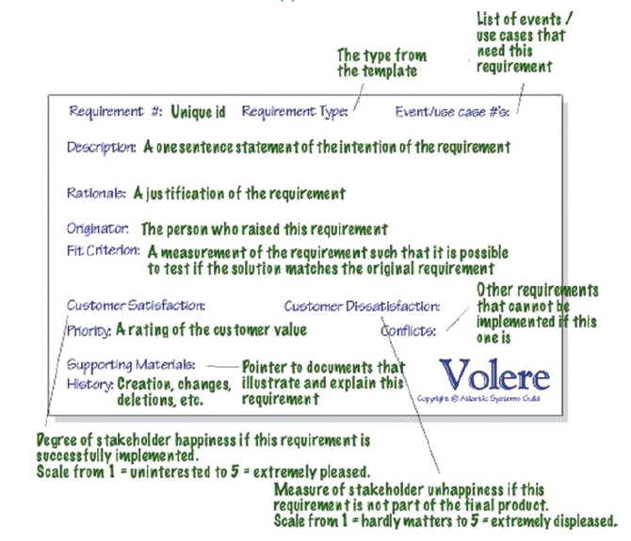
What are requirements?

Slide 9
User Stories
An alternative way to capture what a product is intended to do is via user stories
User stories communicate requirements between team members.
User stories may also be used to capture usability and user experience goals.

Slide 10
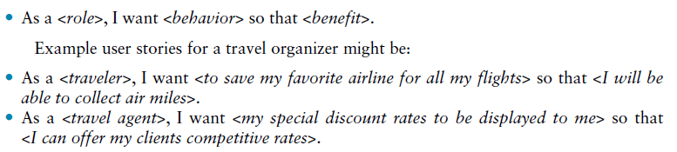
Example

Slide 11
Epic
An epic is a user story that may take weeks or months to implement.
Epics will be broken down into smaller chunks of effort (user stories), before they are pulled into a sprint

Slide 12
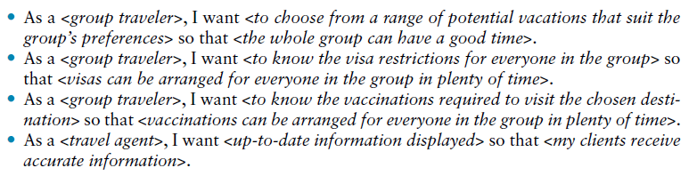
Example

Slide 13
Traditional Requirements
There are two different kinds of requirements
Functional requirements, which describe what the product will do
Nonfunctional requirements, which describe the characteristics (sometimes called constraints) of the product.

Slide 14
Extensive Requirement Types
1. Functional requirements capture what the product will do.
2. Data requirements capture the type, volatility, size/amount, persistence, accuracy, and value of the required data.

Slide 15
Extensive Requirement Types
3. Environmental requirements, or context of use, refer to the circumstances in which the interactive product will operate.
Physical environment, such as how much lighting, noise, movement, and dust is expected in the operational environment.
Social environment deals with issues regarding the social aspects of interaction design, such as collaboration and coordination.

Slide 16
Extensive Requirement Types
4. Organizational environment, for example, how good is user support likely to be, how easily can it be obtained, and are there facilities or resources for training, how efficient or stable is the communications infrastructure
5. Technical environment will need to be established. For example, what technologies will the product run on or need to be compatible with, and what technological limitations might be relevant?

Slide 17
Extensive Requirement Types
6. User characteristics capture the key attributes of the intended user group, such as the users’ abilities and skills, and depending on the product, also their educational background, preferences, personal circumstances, physical or mental disabilities, and so on.
The collection of characteristics for a typical user is called a user profile.
7. Usability goals and user experience goals are another kind of requirement, and they should be captured together with appropriate measures.

Slide 18
Example
Suggest some key requirements in each category (functional, data, environmental, user characteristics, usability goals, and user experience goals) for the following situation
An interactive product for navigating around a shopping center.

Slide 19


Example
Functional:
The product will locate places in the shopping center and provide routes for the user to reach their destination.
Data
The product needs access to GPS location data for the user, maps of the shopping center, and locations of all the places in the center. It also requires knowledge about the terrain and pathways for people with different needs.

Slide 20

Example
Environmental
The product design needs to take into account several environmental aspects. Users may be in a rush, or they may be more relaxed and wandering about. The physical environment will be noisy and busy, and users may be talking with friends and colleagues while using the product. Support or help with using the product may not be readily available, but the user can probably ask a passerby for directions if the app fails to work.

Slide 21

Example
User Characteristics
Potential users are members of the population who have their own mobile device and for whom the center is accessible. This suggests quite a wide variety of users with different abilities and skills, a range of educational backgrounds and personal preferences, and different age groups.

Slide 22

Example
Usability Goals
The product needs to be easy to learn so that new users can use it immediately, and it should be memorable for more frequent users. Users won’t want to wait around for the product to display fancy maps or provide unnecessary detail, so it needs to be efficient and safe to use; that is, it needs to be able to deal easily with user errors.

Slide 23

Example
User Experience Goals
most likely to be relevant here are satisfying, helpful, and enhancing sociability. While some of the other goals may be appropriate, it is not essential for this product to, for example, be cognitively stimulating.

Slide 24
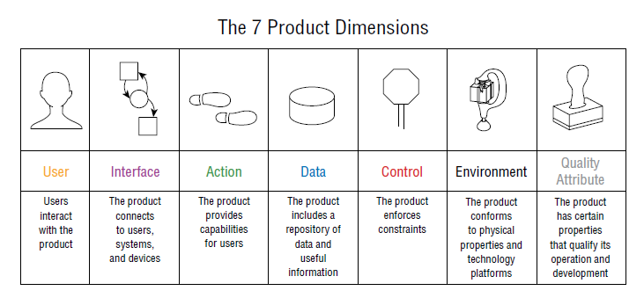
Product Dimension

Slide 25
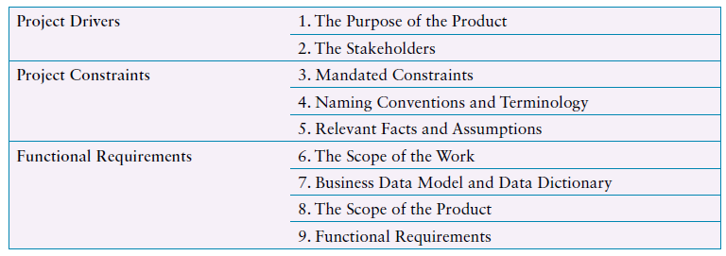
Requirement Categories

Slide 26
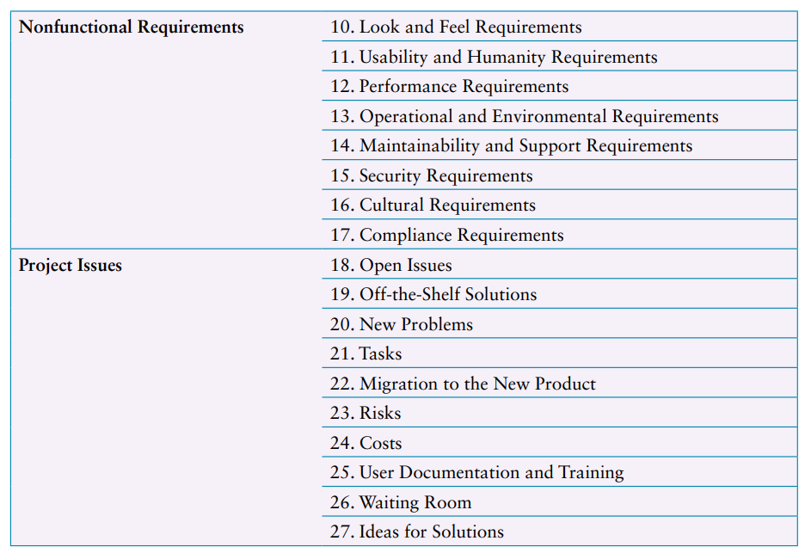
Requirement Categories

Slide 27
Data Gathering for Requirements
Data gathering for requirements covers a wide spectrum of issues, including
who are the intended users
the activities in which they are currently engaged
their associated goals
the context in which the activities are performed
the rationale for the current situation.
The goals for the data gathering is to discover all types of requirements relevant for the product.

Slide 28
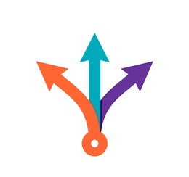
Ways to Gather Requirements
Documentation
manuals, standards, or activity logs
it doesn’t involve stakeholder time
Researching other products
Interviews
to target specific user groups
Questionnaire
to reach a wider population
Observation
to understand the context of the activity
Focus Group
to build a consensus view
Think Aloud Evaluation
Ethnographic Study

Slide 29
Using Probes to Engage with Users
Cultural Probes
Based on a specific culture
Design Probes
Based on specific question or context
Technology Probes
Include technology kits
Proactive Probes
to challenge existing norms and attitudes in order to provoke discussion

Slide 30
Contextual Inquiry
Contextual Inquiry is a user-centered design approach that explicitly defines how to gather, interpret, and model data about how people live, in order to drive design ideation.
Contextual Interviews focus on matters of daily life (work and home) that are relevant for the project scope.

Slide 31
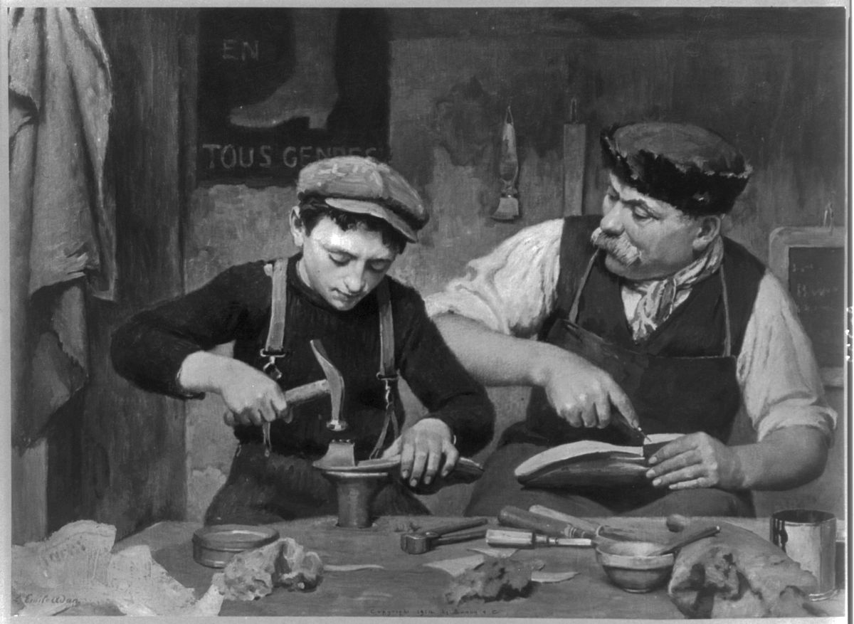
Apprenticeship Relation
Contextual inquiry uses a model of master/apprentice to structure data gathering, based on the idea that the interviewer (apprentice) is immersed in the world of the user (master), creating an attitude of sharing and learning on either side.

Slide 32
Apprenticeship Relation
This approach shifts the perceived “power” relationship that can exist in a more traditional interviewer–interviewee relationship.
Users talk as they “do,” and the apprentice learns by being part of the activity while also observing it, which has all of the advantages of observation and ethnography.
Hidden and specific details that people don’t make explicit, and don’t necessarily realize themselves, emerge this way and can be shared and learned.
While observing and learning, the apprentice focuses on why, not just what.

Slide 33
Apprenticeship Model Principles
Context principle emphasizes the importance of going to the user, wherever they are, and seeing what they do as they do it.
Partnership principle creates a collaborative context in which the user and interviewer can explore the user’s life together, on an equal footing.
Interpretation principle turns the observations into a form that can be the basis of a design hypothesis or idea.
Focus principle is to guide the interview setup and tells the interviewer what they need to pay attention to among all of the detail that will be unearthed.

Slide 34
Cool Concepts of Contextual Interviews
Seven cool concepts are divided into two groups
four concepts that enhance the joy of life and
three concepts that enhance the joy of use.
During a contextual interview, cool concepts are identified as the user does their activity, although often they only emerge retrospectively when reflecting on the session.

Slide 35
Joy of Life Concepts
The joy of life concepts capture how products make our lives richer and more fulfilling. These concepts are
Accomplish (empower users)
Connection (enhance real relationships)
Identity (support users’ sense of self)
Sensation (pleasurable moments).

Slide 36
Joy of Use Concepts
The joy of use concepts describes the impact of using the product itself; they are:
Direct in action (provide fulfilment of intent)
Hassle factor (remove all glitches and inconveniences)
Learning delta (reduce the time to learn).

Slide 37
Parts of Contextual Interviews
Getting an overview
introducing each other and setting the context of the project.
The transition
both parties get to know each other, and the nature of the contextual interview engagement is set up
Main interview
core data gathering session when the user continues with their activities and the interviewer observes them and learns
Wrap-up
sharing some of the patterns and observations the interviewer has made

Slide 38
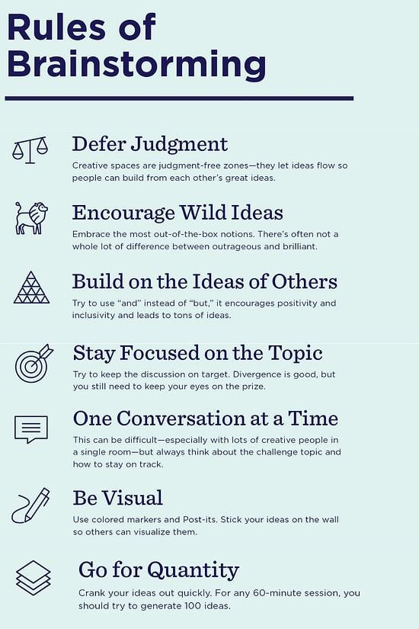

Brainstorming for Innovation
Brainstorming is a generic technique used to generate, refine, and develop ideas

Slide 39
Bringing Requirement to Life
Two techniques that are commonly used to augment the basic requirements information and to bring requirements to life
Personas
Scenarios
They can also guide development throughout the product lifecycle.

Slide 40

Persona
Personas (Cooper, 1999) are rich descriptions of typical users of the product under development on which the designers can focus and for which they can design products.
A persona has two goals
To help the designer make design decisions
To remind the team that real people will be using the product

Slide 41
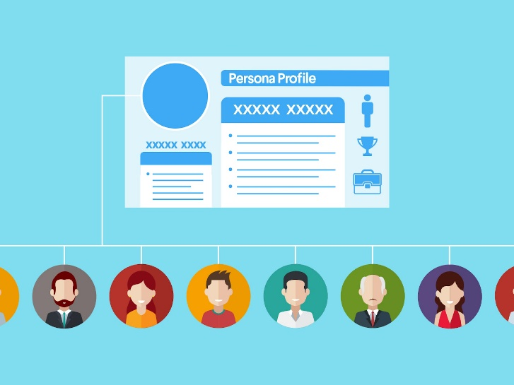
Persona
A persona will include a description of the user’s behavior, attitudes, activities, and environment.
Each persona is characterized by a unique set of goals relating to the particular product under development.
Product will usually require a small set of personas rather than just one.
Any one persona represents a synthesis of a number of real users

Slide 42
Constructing Persona
Identify behavioral variables.
Map interview subjects to behavioral variables.
Identify significant behavior patterns.
Synthesize characteristics and relevant goals.
Check for redundancy and completeness.
Expand description of attributes and behaviors.
Designate persona types.

Slide 43
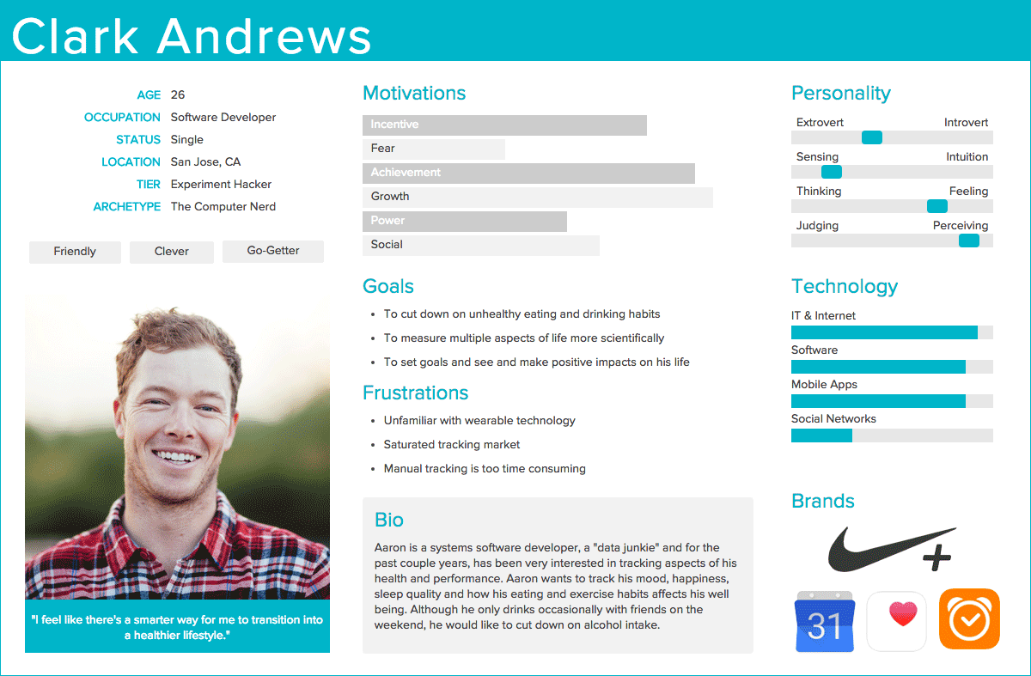
Example

Slide 44

Class Activity
Develop two personas for a group travel organizer app that supports a group of people, perhaps a family, who are exploring vacation possibilities together. Use the common persona structure of a photo, name, plus key goals, user quotes, behaviors, and some background information. Personas are based on real people, so choose friends or relatives that you know well to construct them.

Slide 45
Scenarios
A scenario is an “informal narrative description” (Carroll, 2000). It describes human activities or tasks in a story that allows exploration and discussion of contexts, needs, and requirements.
Understanding current behavior also allows the designer to explore the constraints, contexts, irritations, facilitators, and so on, under which people operate.

Slide 46
Scenarios
The focus of scenarios is about what the users are trying to achieve, that is, their goals
Scenarios may be constructed as textual descriptions, like those shown previously, but they can also use audio or video.
A scenario describes one use of a product or one example of achieving a goal, while a persona characterizes a typical user of the product.

Slide 47
Scenario Types
Context Scenario
It is used to explore, at a high level, how the product can best serve the needs of the personas
Focus on human activities, perceptions, and desires
Validation Scenario
More specifically describing user interactions with the product.
Focus on the most significant user interactions
Keypath Scenario
To test the design solution in a variety of situations (what if)
Focus on less frequent or less important interactions

Slide 48
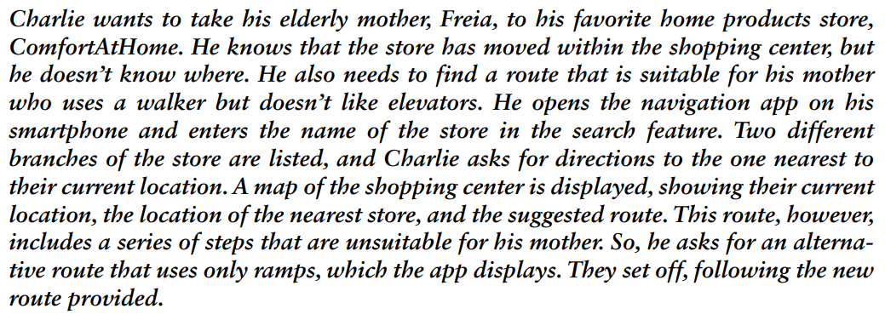
Example

Slide 49
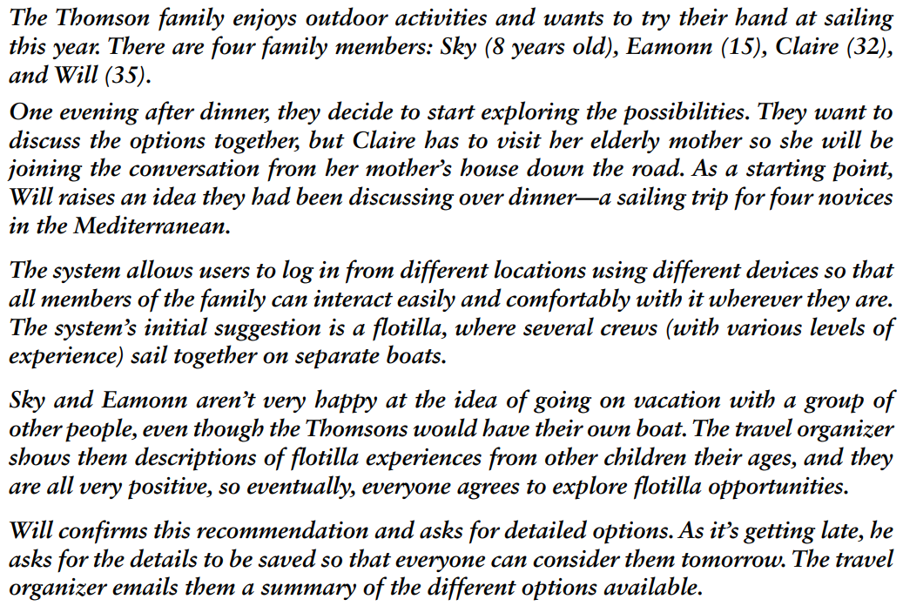
Example

Slide 50
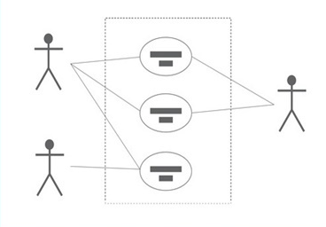
Capturing Interaction with use Cases
Use cases focus on functional requirements and capture interaction
Use cases define a specific process because they are a step-by-step description. This is in contrast to a user story, which focuses on outcomes and user goals

Slide 51
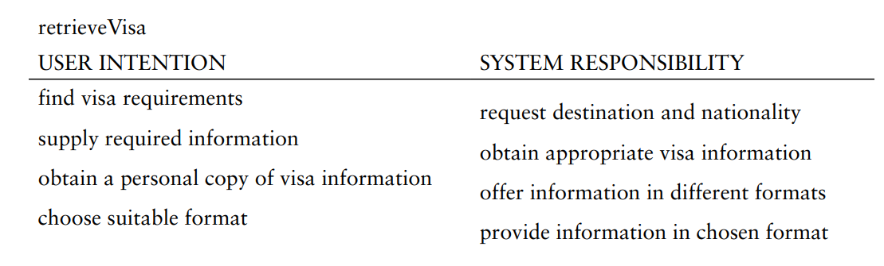
Use Case Styles
Essential Use Cases
focuses on the division of tasks between the product and the user.

Slide 52
Use Case Styles
System Use Cases
It captures the user’s goal when interacting with the product
The main use case describes the normal course, that is, the set of actions most commonly performed.
Other possible sequences, called alternative courses, are then captured at the bottom of the use case.

Slide 53
Use Case Styles – SUC Example
Normal Course
The product asks for the name of the destination country.
The user provides the country’s name.
The product checks that the country is valid.
The product asks the user for their nationality.
The user provides their nationality.
The product checks the visa requirements of that country for a passport holder of the user’s nationality.
The product provides the visa requirements.
The product asks whether the user wants to share the visa requirements on social media.
The user provides appropriate social media information.

Slide 54
Use Case Styles – SUC Example
Alternative Courses
4. If the country name is invalid:
4.1 The product provides an error message.
4.2 The product returns to step 1.
6. If the nationality is invalid:
6.1 The product provides an error message.
6.2 The product returns to step 4.
7. If no information about visa requirements is found:
7.1 The product provides a suitable message.
7.2 The product returns to step 1.

Slide 55
Conclusion
Introduction
What why and how?
What are requirements
Data gathering for requirement
Personas and Scenarios
Capturing Interaction with use cases.

